Slide 1
SEA Score Customer Survey Results 2020
Informa Financial Intelligence

Slide 2
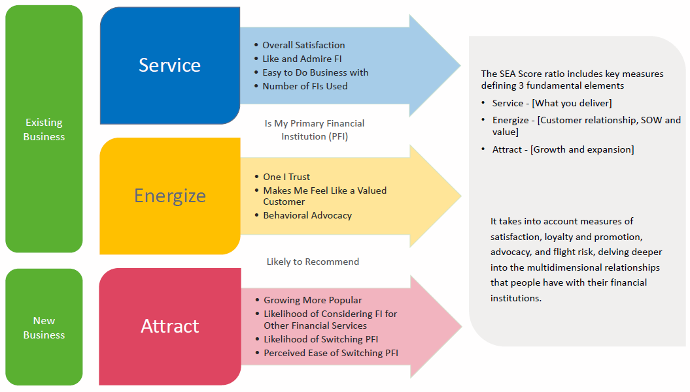
SEA Score Overview
The survey measures three fundamental areas – Service, Relationship Expansion and Acquisition

Slide 3
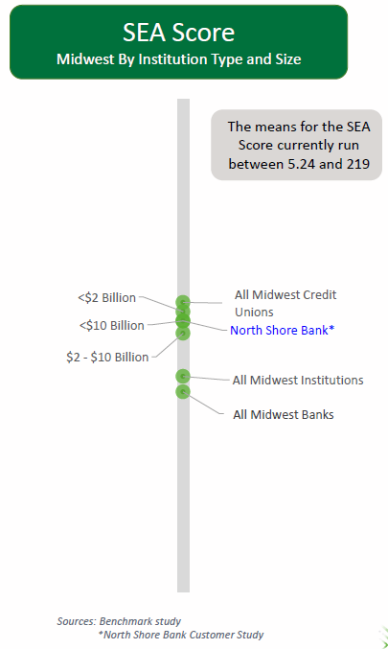
North Shore bank vs Midwest FI’s
In August over 1,200 customers completed the survey.
The survey evaluates our customer responses and then compares them to competitors in the market.
North Shore Bank 2020 SEA Score remained steady with 2019. Peer banks in the Midwest < $10 billion dropped six points.
Our score is above peer banks between $2 - $10 billion.
Midwest Credit Unions continue to outperform banks.

Slide 4
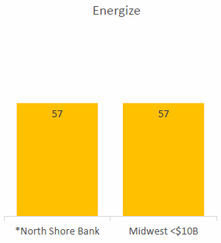
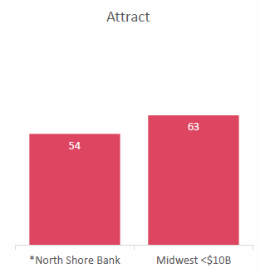
KEY FINDINGs
When compared to our Midwest peers, we are seen as superior in service; equal in ability to engage and expand relationships; and strengthening in ability to attract new business.
Service is our powerhouse.
Our customers score us higher in all service areas than other financial institutions they use.
The Energize score remained steady and on par with competitors.
Customers feel trusted and more valued than other financials they use.
The Attract score has strengthened since 2019 and gaining traction while other Midwest peers have declined.
This is an area of opportunity.

Slide 5
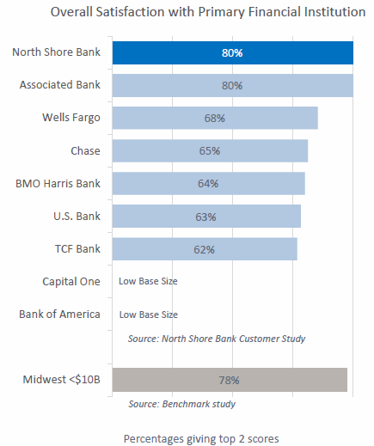
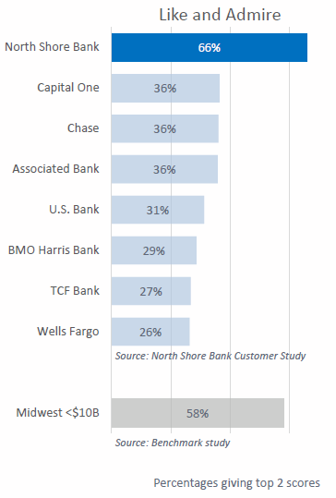
SERVICE KEY FINDINGS

Slide 6
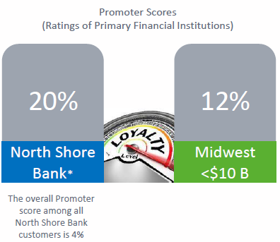
Service KEY FIndings
Net Promoter Score
Our net promoter score is well above competition.
Primary North Shore Bank customers were more likely to promote us than customers of other Midwest banks they use.

Slide 7
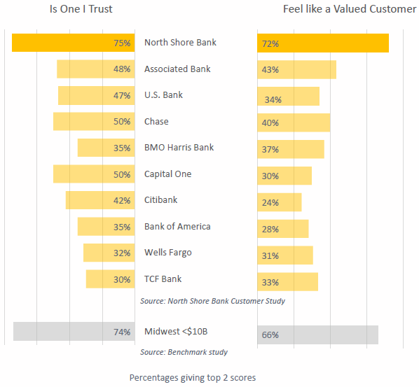
Energize KEY FINDINGS

Slide 8
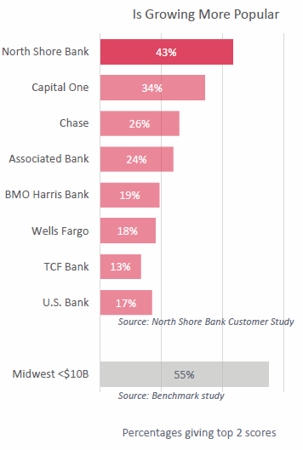
Attract KEY FINDINGS

Slide 9
Opportunity AND Next steps
Service | Energize | Attract
The strength of our Service score reflected in “The Bank of You” brand. Customer’s recognize this and are willing to tell others. Our service strength can be leveraged to impact our ability to expand and grow. | Our Energize scores are a great foundation on which to build momentum. Historically solid Energize scores indicates customers are available to help us grow by deepening current relationship and telling others. There is opportunity leverage customer feelings and translate into additional and new business. | Our attract scores in the area of customer affinity can be translate this energy into advocacy. Growing more popular means there is opportunity for us to appeal to new customers and perform better in this area.
2021 Strategies to Attract and Grow Brand Awareness Focus outwardly on the needs of consumers it wishes to attract in greater numbers. Utilize social media and customer-focused marketing to promote financial solutions that appeal to the younger generations and those with young families Advocacy Sales of additional products and services to existing customers; target marketing, SOAR conversations, business partner referrals and word-of-mouth promotions. Digital strategy initiatives as a focus to attract younger generations.

